Slide 1

Case Study 1: How Does a Bike-Share Navigate Speedy Success?
#Data
By: Kamau Miller

Slide 2
Background
•Cyclistic is a fictional bike-sharing company in Chicago.
•Cyclistic offers flexible pricing plans, including single-ride passes, full-day passes, and annual memberships.
•Financial analysis indicates that annual members are more profitable than casual riders.
•Executive Leadership believes that maximizing the number of annual members will be key to future growth.
•I was tasked with digging into the company’s historical bike trips to identify trends to help the company design marketing strategies aimed at converting casual riders into annual members.

Slide 3
STEP 1: ASK
1. How do annual members and casual riders use Cyclistic bikes differently?
2. Why would casual riders buy Cyclistic annual memberships?
3. How can Cyclistic use digital media to influence casual riders to become members?
-My analysis will be on comparing the annual members and casual riders.
• Key Stakeholders:
• Lily Moreno — Director of the marketing team and my manager.
• Cyclistic executive team

Slide 4
STEP 2: PREPARE
• Zip files consisting of Cyclistic customer data from August 2022-July 2023 was downloaded and saved as CSV files.
• Files had consistent formatting with the following column names: ride_id , rideable_type, started_at, ended_at, start_station_name, start_station_id, end_station_name, end_station_id, start_lat, start_lng, end_lat, end_lng, member_casual.
•There are 5,723,613 rows across all files.
•Data files were made available under the following license-agreement.

Slide 5
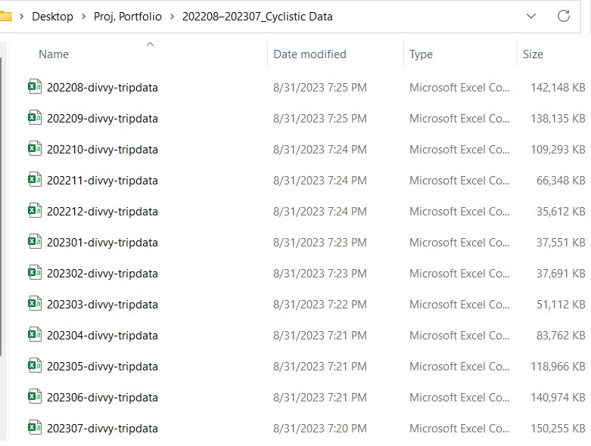
STEP 2: PREPARE CONT’D

Slide 6
STEP 3: PROCESS
• SQL and Excel were my chosen tools of choice since CSV files can be imported into SQL.
•Upon being uploaded into SQL data can be filtered and cleaned to gain valuable insights.
•Data was verified to be clean by analyzing the cleaned version to ensure that all information is uniform and consistent across all files.
•The cleaning process is documented within this presentation and files are saved in the Project Portfolio folder.

Slide 7
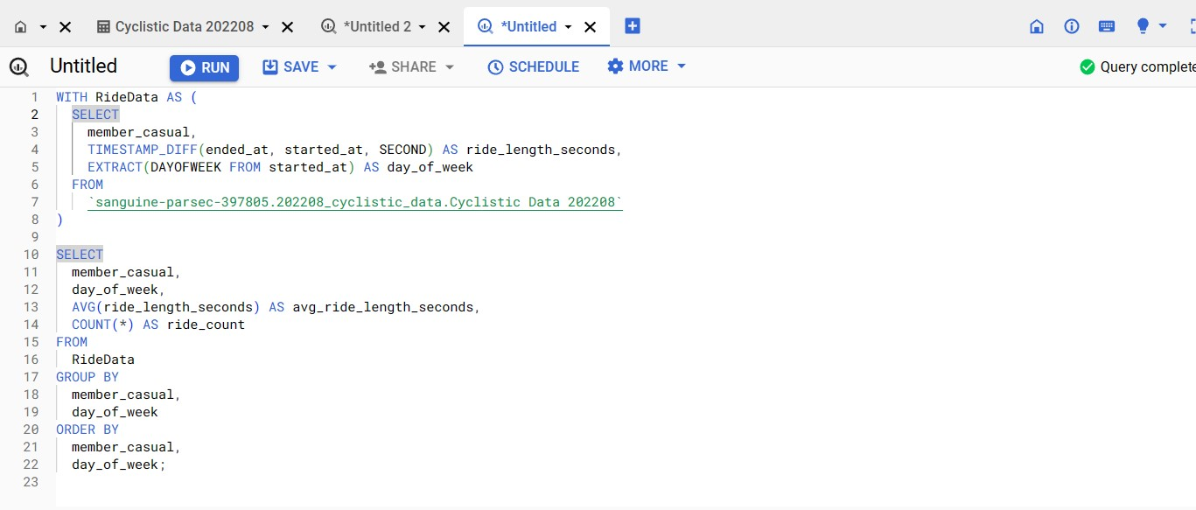
STEP 3: PROCESS CONT’D

Slide 8
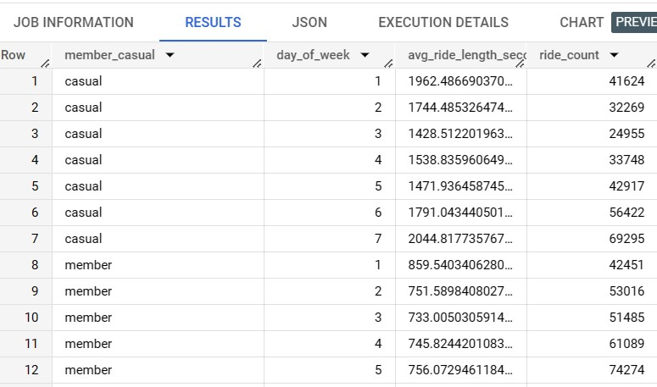
STEP 3: PROCESS CONT’D

Slide 9
STEP 4: Analyze
• SQL and Excel were my chosen tools for this phase.
•SQL was used to merge the 12 CSV files into one file.
•Excel was used to further clean the data and gain the average ride time and number of trips for each day of the week over the past year.
•Similarities between casual and annual customers are that they ride the most from Saturday through Monday.
•Differences I noticed is that casual riders have longer ride times while annual members take more trips.

Slide 10
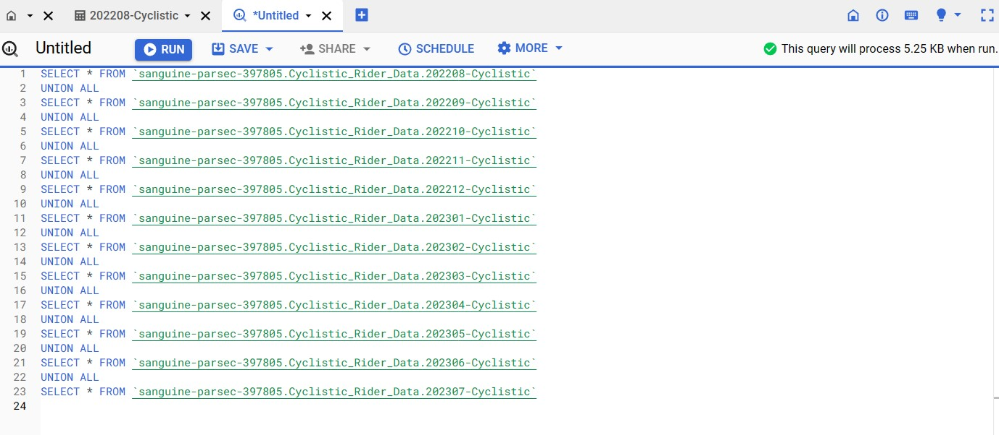
STEP 4: ANALYZE CONT’D

Slide 11
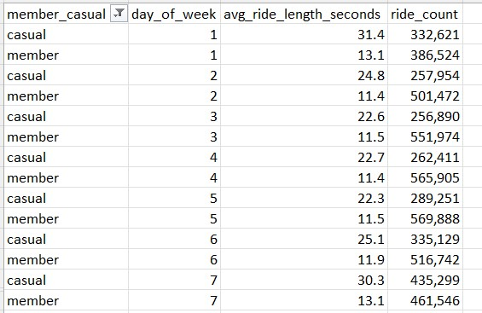
STEP 4: ANALYZE CONT’D

Slide 12
STEP 5: SHARE
• Tableau was my tool of choice to visualize the data that was prepared and processed in previous steps.
•The visualization shows clearly how casual and annual customers use Cyclistic bikes differently.
•Casual customers take fewer bike trips, but they ride for longer durations.
• Casual customer peak ridership activity is between Saturday and Monday.

Slide 13
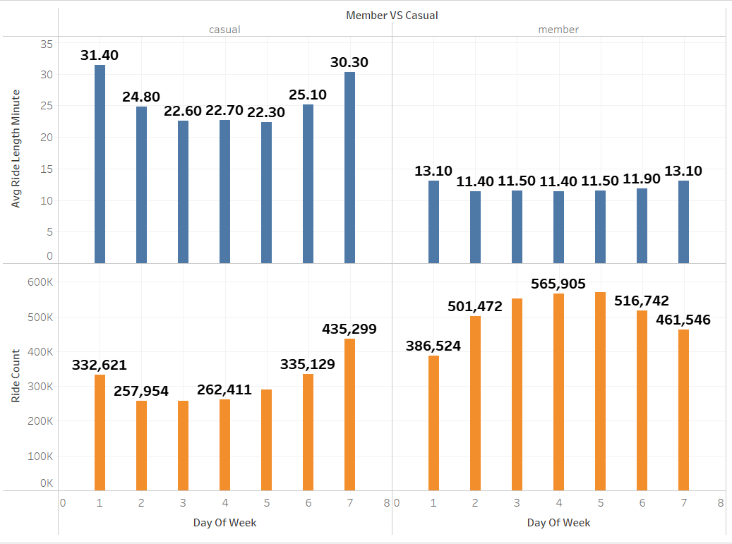
STEP 5: SHARE CONT’D

Slide 14
STEP 6: ACT
• Create a rewards program that offers incentives for Cyclistic Riders based on how many miles they ride in per quarter.
•Make signing up for the annual subscription a requirement to participate in the rewards program.
•Create a referral program for current annual riders. Annual riders that refer new casual riders will receive a 20% discount on their annual membership for the next year.
•Create an advertisement campaign directed at casual customers. Be sure to advertise to them between Saturday and Monday.

Slide 15
Please
Follow
SHARE
Like + Subscribe
Me on LinkedIn
My video to help others

